Slide 1


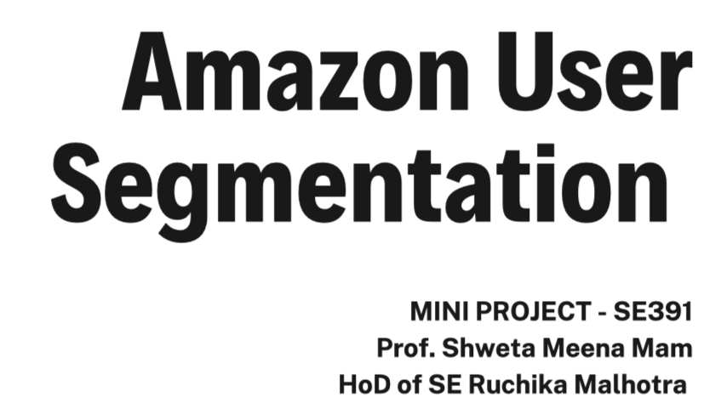
DAVIN BRAVEN - 2K20/SE/09

Slide 2
Objective
Machine Learning & AI
Data Preprocessing
Clustering
K-Means Clustering
K-Means Random Intialization Trap
Future Work
References
End - Thank You
Contents
Amazon User Segmentation

Slide 3

OBJECTIVE
Amazon Personalize now offers intelligent user segmentation which allows you to run more effective prospecting campaigns through your marketing channels. Traditionally, user segmentation has relied on demographic information and manually curated business rules to make assumptions about users’ intentions and assign them to pre-defined audience segments. Amazon Personalize uses machine learning techniques to learn about your items, users, and how your users interact with your items. Amazon Personalize segments users based on their preferences for different products, categories, brands, and more. This can help you drive higher engagement with marketing campaigns, increase retention through targeted messaging, and improve the return on investment for your marketing spend.

Slide 4

What is Machine Learning & AI ?

Slide 5


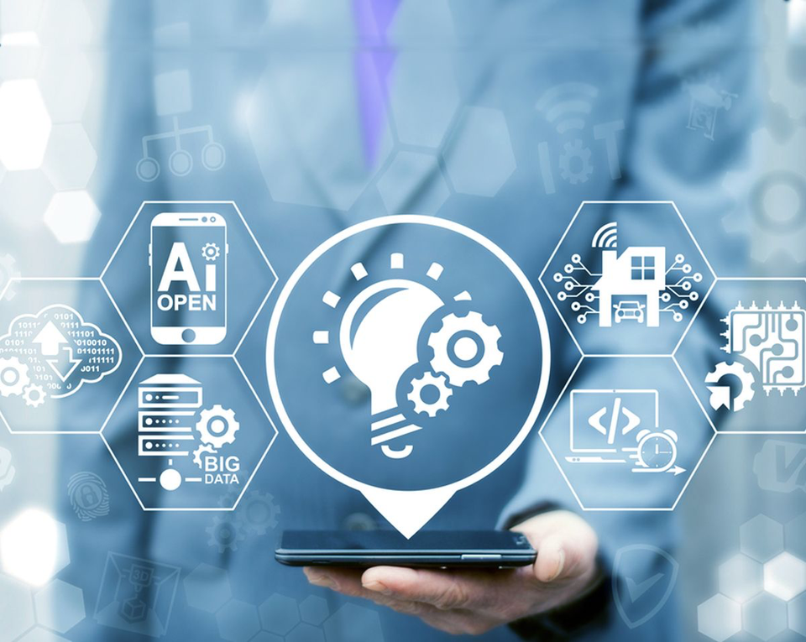
Machine Learning
Definition :
Machine learning is a branch of artificial intelligence (AI) and computer science which focuses on the use of data and algorithms to imitate the way that humans learn, gradually improving its accuracy.

Slide 6
Artificial Intelligence
Definition :
" It is the science and engineering of making intelligent machines, especially intelligent computer programs. It is related to the similar task of using computers to understand human intelligence, but AI does not have to confine itself to methods that are biologically observable."

Slide 7

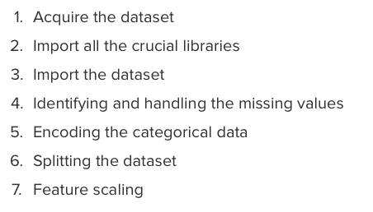
Data Pre Processing - ML
Data preprocessing in Machine Learning is a crucial step that helps enhance the quality of data to promote the extraction of meaningful insights from the data. Data preprocessing in Machine Learning refers to the technique of preparing (cleaning and organizing) the raw data to make it suitable for a building and training Machine Learning models. In simple words, data preprocessing in Machine Learning is a data mining technique that transforms raw data into an understandable and readable format.

Slide 8
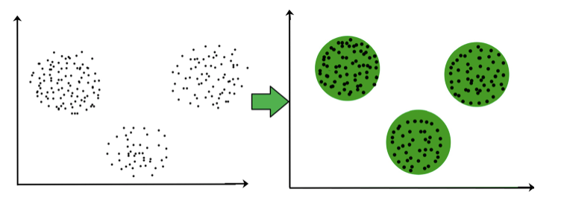
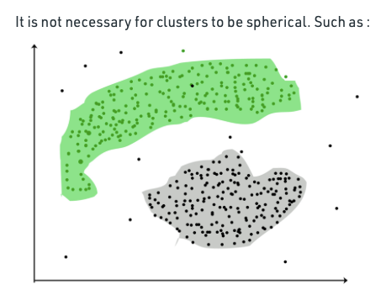
For ex– The data points in the graph below clustered together can be classified into one single group. We can distinguish the clusters, and we can identify that there are 3 clusters in the below picture.
Clustering
Clustering is the task of dividing the population or data points into a number of groups such that data points in the same groups are more similar to other data points in the same group and dissimilar to the data points in other groups.

Slide 9
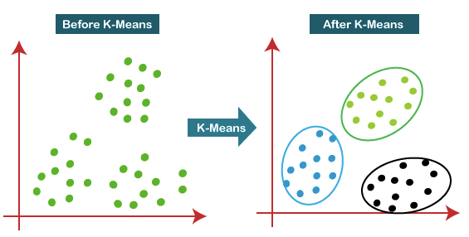
The algorithm takes the unlabeled dataset as input, divides the dataset into k-number of clusters, and repeats the process until it does not find the best clusters. The value of k should be predetermined in this algorithm.
case
K-Means
Clustering
K-Means Clustering is an Unsupervised Learning algorithm, which groups the unlabeled dataset into different clusters.

Slide 10
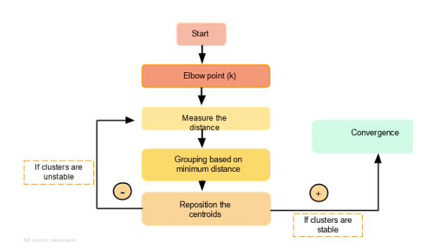
How Does K-Means Works ?

Slide 11
K-Means Clustering Steps
01
02
03
04
05
Data
Pre Processing
Step
Importing the Libraries and Data Set
Finding the optimal number of clusters using the elbow method
Training the
K-means algorithm on the training dataset
Visualizing the Clusters

Slide 12
case
Random Initialization Trap
Random initialization trap is a problem that occurs in the K-means algorithm. In random initialization trap when the centroids of the clusters to be generated are explicitly defined by the User then inconsistency may be created and this may sometimes lead to generating wrong clusters in the dataset. So random initialization trap may sometimes prevent us from developing the correct clusters.
Random initialization trap is a problem that occurs in the K-means algorithm.

Slide 13

Amazon User Segmentation

Slide 14
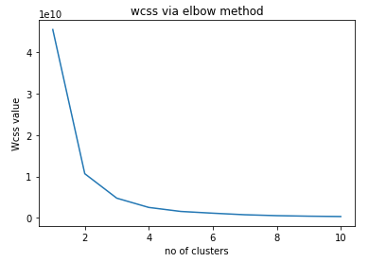

Slide 15
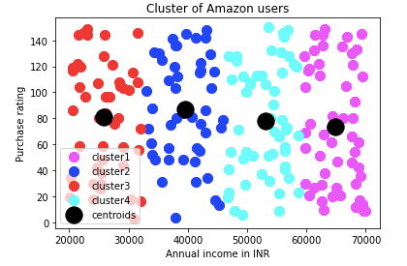
case
Cluster of Amazon Users

Slide 16
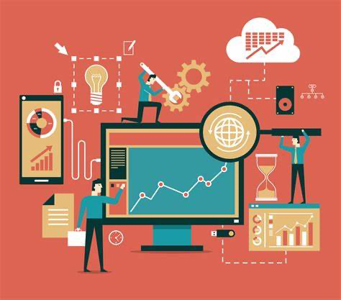
Future Work
01
Target large enterprises.
Retrain low-performing coordinators.
02
Implement the new system.
03
Assign high performers to new territories.
04
Present 2025 targets at annual staff meeting.
05

Slide 17
References
Maching Learning book (By Dr. Bret Lantz)
01
Machine Learning with Python book (By Daniel Geron)
02
03
GeeksforGeeks and Javapoint
04
TowardsDataScience - Website
05
Google Colab and Jupyter

Slide 18


Thank You!
DAVIN BRAVEN - 2K20/SE/09

